Slide 1
Analysis of Properties
Portfolio Project
Meriem Touri

Slide 2
Introduction
Project Objective
Analysing the properties database contribute to our understanding, response, and management of the properties market.
The goal of this project is to analyse a real estate dataset to uncover trends, patterns, and potential investment opportunities. By applying data analysis techniques, we aim to provide actionable insights for property investors, real estate agents, and individuals interested in the real estate market.
Methodology
The data was collected by ALLEGHENY COUNTY OFFICE OF PROPERTY ASSESSMENT
The data has been analysed using Python visualisation tools

Slide 3
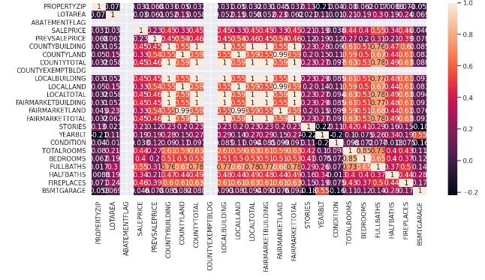
Analyzing properties performance, sale behavior and market trends

Slide 4
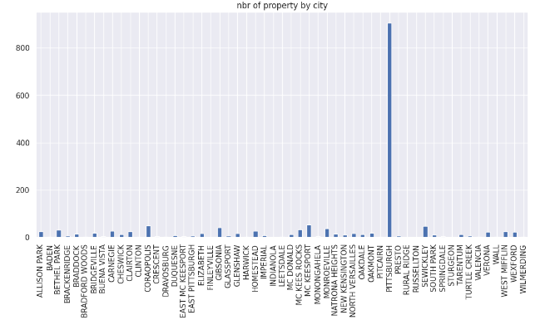
Nbr of property Analysis by city
Numbers of properties are significant more in PITTSBURGH city than any other city.
We will focus our future analysis on this city.

Slide 5
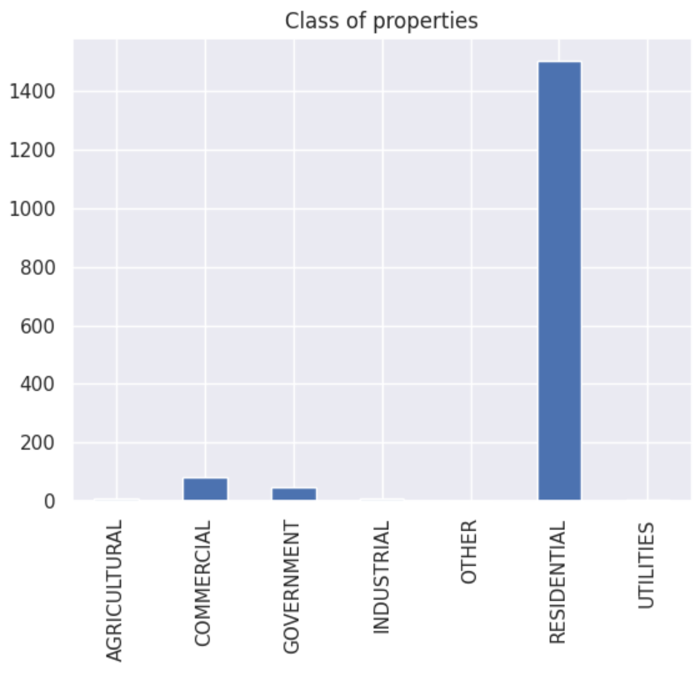
categories for describing the general use of a parcel in PITTSBURGH.
Most of the parcel are residential properties.
Very few are commercial and government properties.
None are agricultural or industrial.

Slide 6
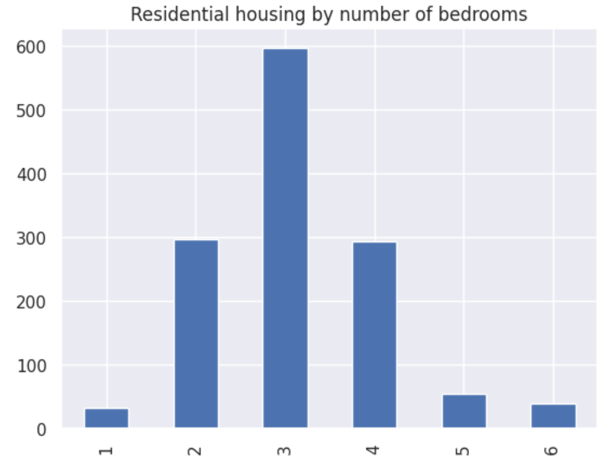
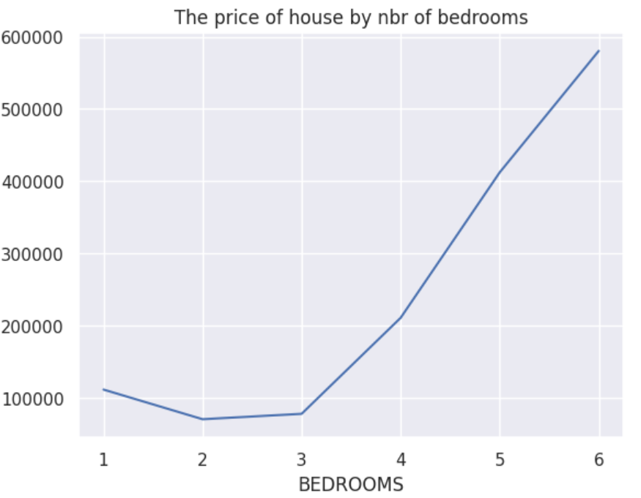
Sales Analysis by Gender

Slide 7
Targeted Marketing Suggestions
Based on the number of rooms, we can see that the properties with 3 bedrooms are the more commun in the city, followed by properties with 2 and 4 bedrooms
our analysis determines that the price of properties is more the more ther is rooms, but as well it tends to increase if there is less properties availbles.
We suggest to increase the numbers of properties with 1 bedroom, and 3 bedrooms, since there is high demand on it.

